Slide 1

Online learning
Designed by: Rku Leaders
Team Members:
Dilip Sarvaiya 18SOECE11051
Parth Galani 18SOECE11014

Slide 2

Challenges
Task 1.
Transforming learning into Amazing e-learning Experiences.
Task 2.
Lack Of Learner Motivation And Engagement.
Task 3.
Staying Up-To-Date With Modern Tech.
Task 4.
Designing e-learning Courses For Different Generations.
Task 5.
Measurable learning outcomes.
Task 6.
Adaptive learner models to accommodate different learner needs.

Slide 3

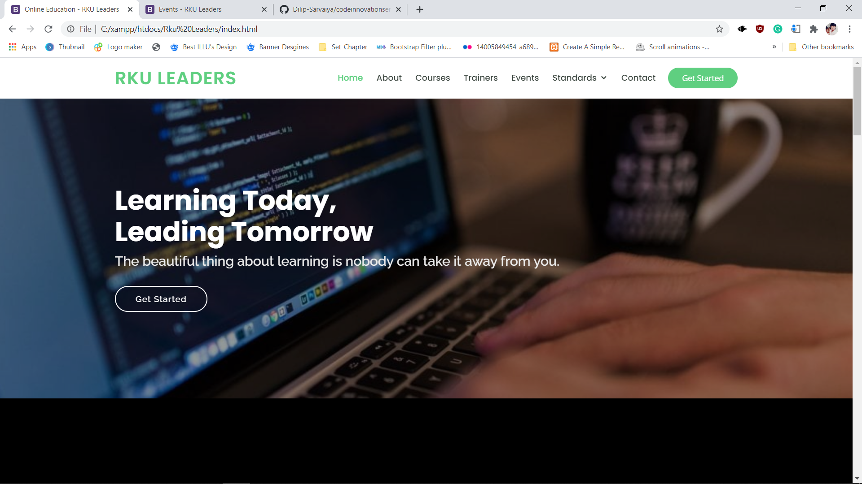
First Task
We will cover these aspects:
Dry and dull subject matter is the bane of every e-learning professional’s existence. You have to use a healthy dose of innovation, creativity, and every resource you can get your hands on to transform it into something engaging and exciting.
But sometimes it isn’t so much the subject matter that’s troublesome, but instead, where the information you’re using to build it comes from.

Slide 4

Second Task
Unfortunately, not every online learner is going to be 100% committed to the e-learning experience. They may be distracted, busy, or simply unmotivated. We live in an age where attention is at a premium and learners have access to more information than they can consume. All of these hurdles prevent them from actively engaging with learning programs.

Slide 5
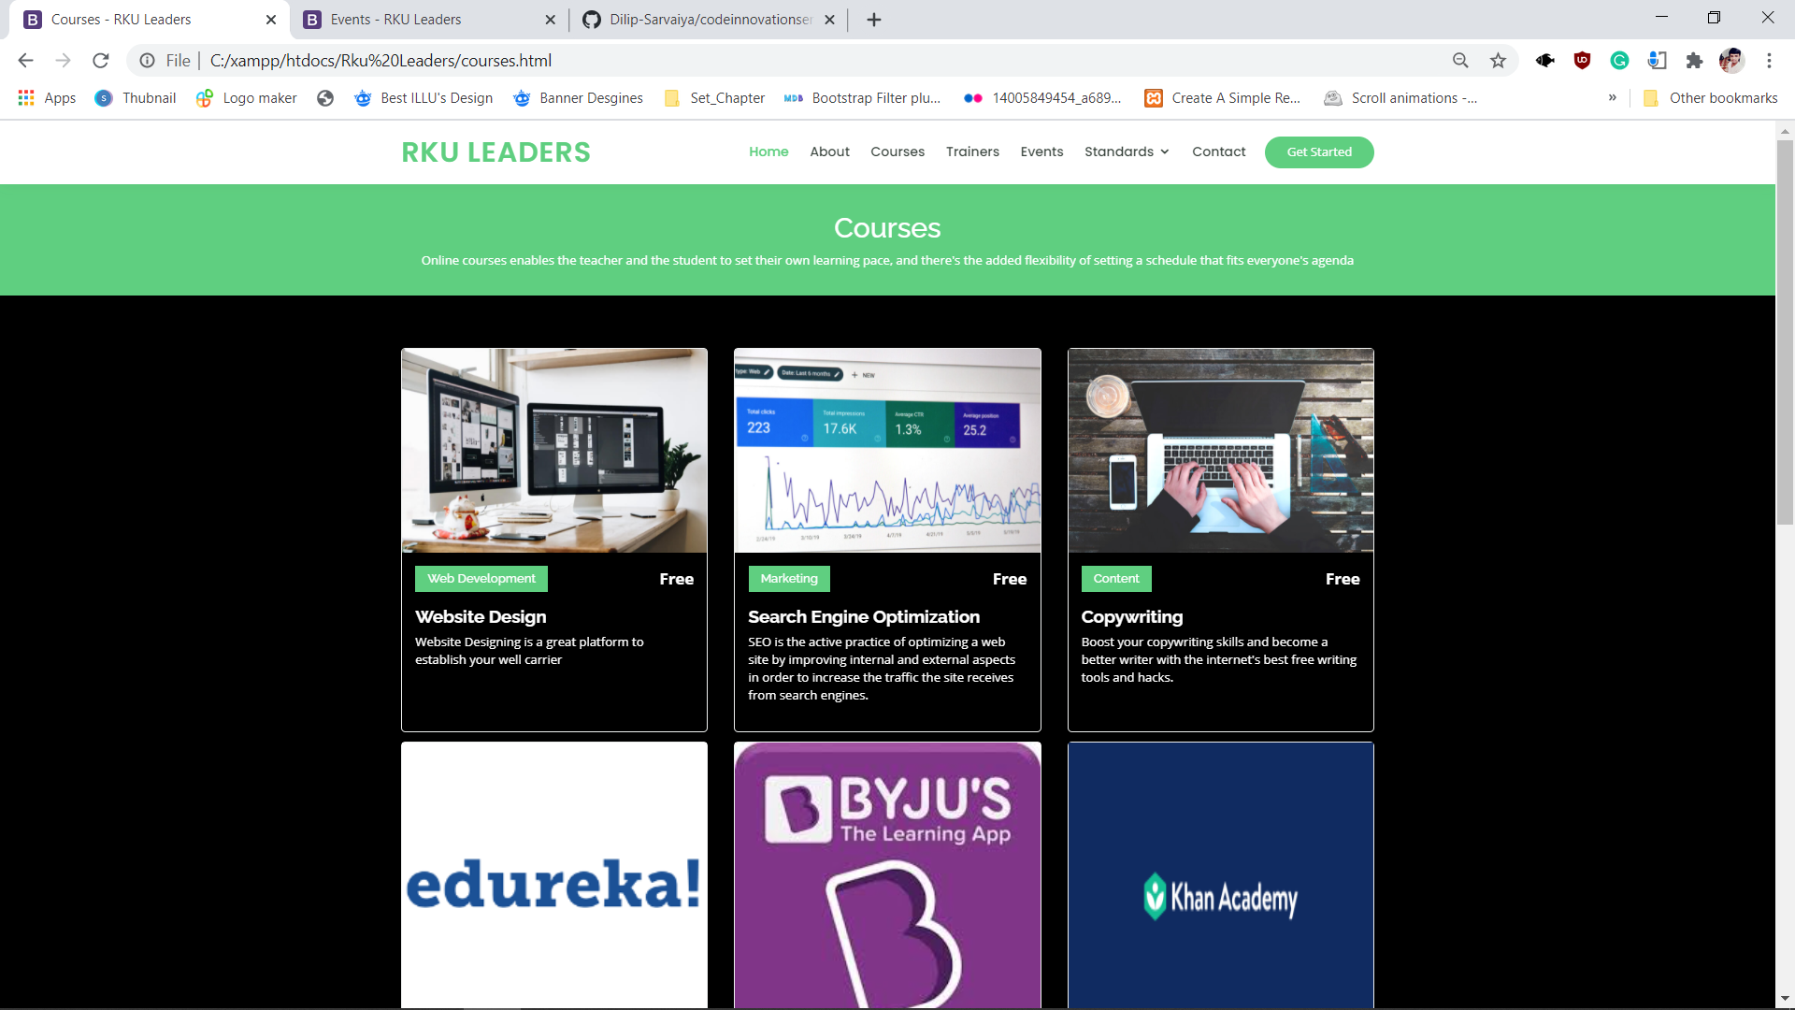
Second Task
To counteract this, you must provide them with an interactive and immersive e-learning course that includes their interests and aligns with their goals. They have to see the value in the e-learning course if you want them to actively participate. Also, great courses are here.
As a start, three key ways to drive engagement are; microlearning, gamification and building hype for upcoming content.

Slide 6

Third Task
Every year welcomes new tech tools, gadgets, and software that you can use to improve e-learning delivery. But which technology is really worth the investment?
Attend tech conferences, e-learning events, and trade shows. Read articles, Video series courses, resources, reviews and even case studies related to these technologies. Doing so keeps you up-to-date with what is being developed and, most importantly, helps you determine whether these modern e-learning tools suit your needs.

Slide 7


Fourth Task
Must elements of Designing eLearning Courses For Different Generations in Higher Ed
Set Learning Free With Device-Agnostic eLearning
Use Microlearning As The New Norm
Leverage The Power Of Shared Learning
Give Control With Personalized eLearning Experiences

Slide 8
Fourth Task
Set Learning Free With Device-Agnostic eLearning
First and foremost, Millennials tend to resist online training that restricts them to a computer screen. With the proliferation of technology, mobile devices (especially smartphones) have become ubiquitous and changed the way individuals interact with the world around them. Millennials want to have the freedom of moving freely from one device to another to get things done
How can you deliver mobile learning?
Set learning free by making your learners able to take their online training wherever they go and access it anytime.
Modern-day rapid eLearning authoring tools such as Articulate Rise, Lectora Inspire, Adobe Captivate, etc., allow the development of a single course that can be accessed on all devices and browsers.

Slide 9
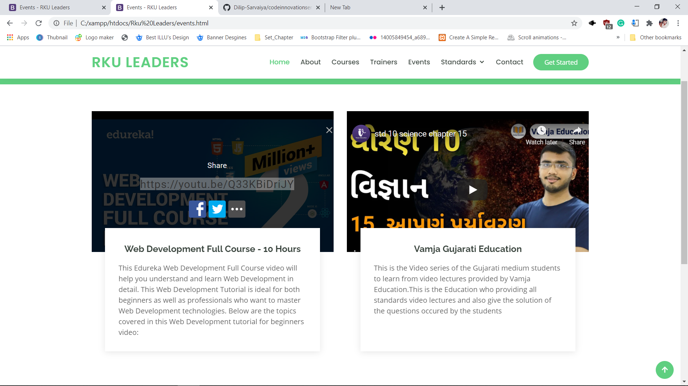
Fourth Task
2. Use Microlearning As The New Norm
The most common format of microlearning that Millennials have grown up with is unarguably the ‘video’.
You can develop short videos for explaining processes, demonstrating products, procedures, and much more.

Slide 10
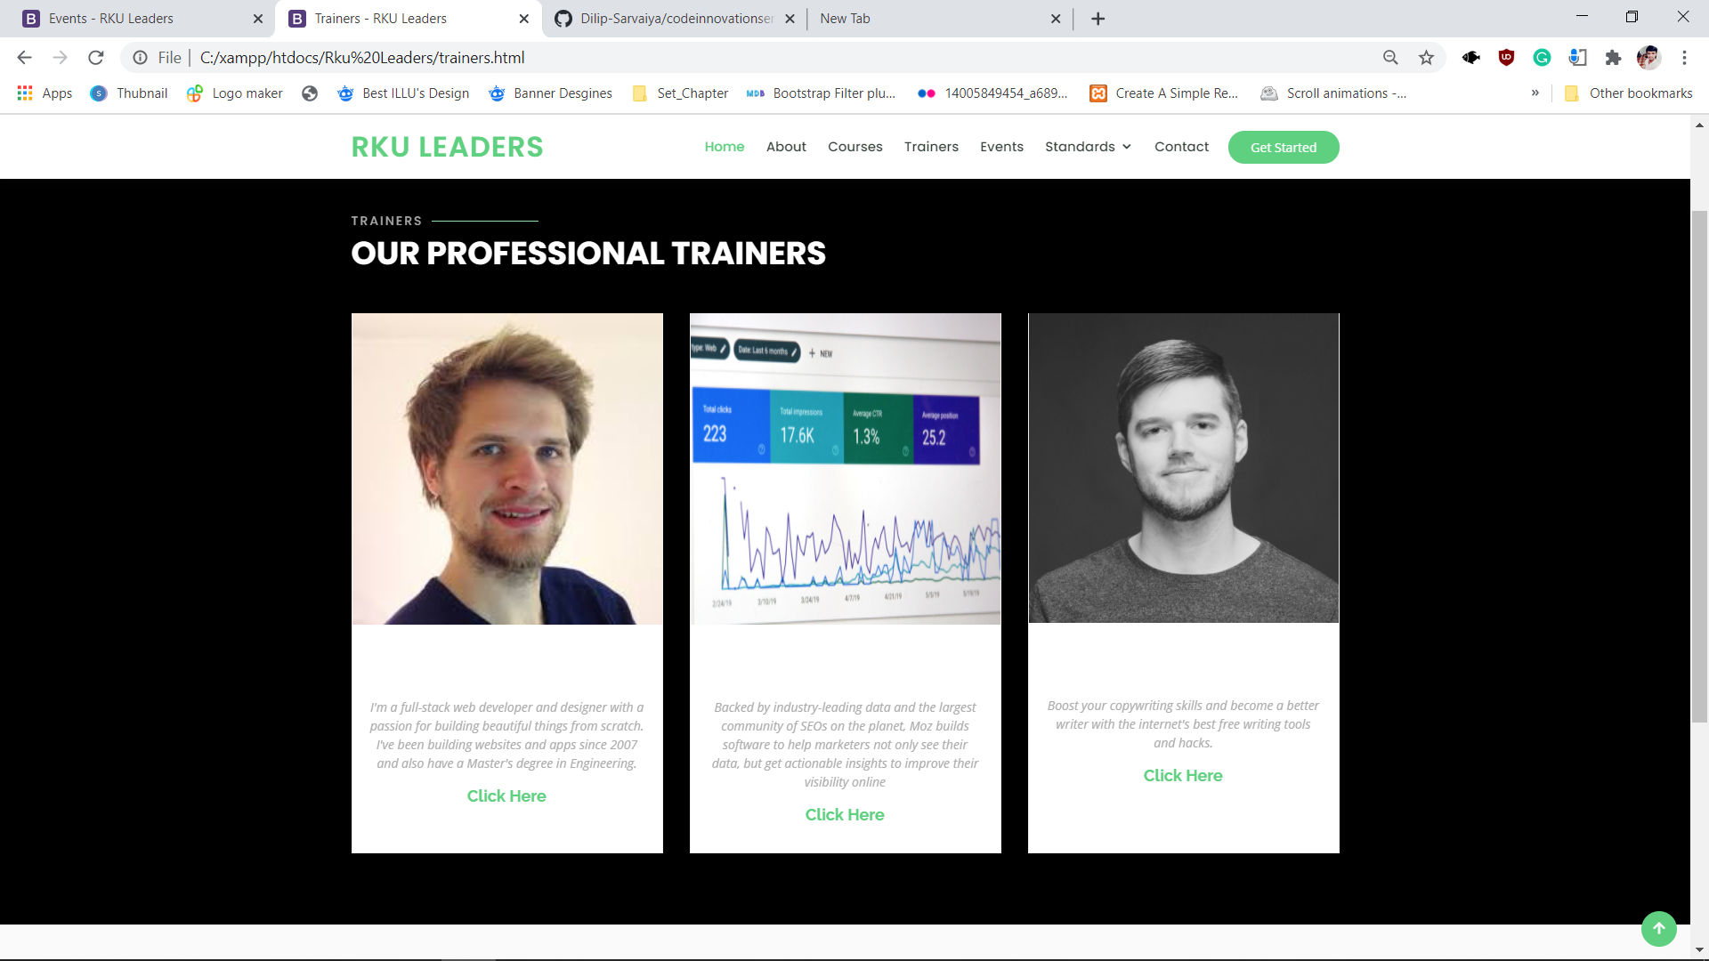
Fourth Task
3. Leverage The Power Of Shared Learning
Social and collaborative learning enables learners to work in groups, who may be geographically dispersed but connected via the Internet.
Active learning and sharing of knowledge
Meaningful takeaways at different points
Enhanced behavioral competencies such as cooperation, problem-solving, teamwork

Slide 11
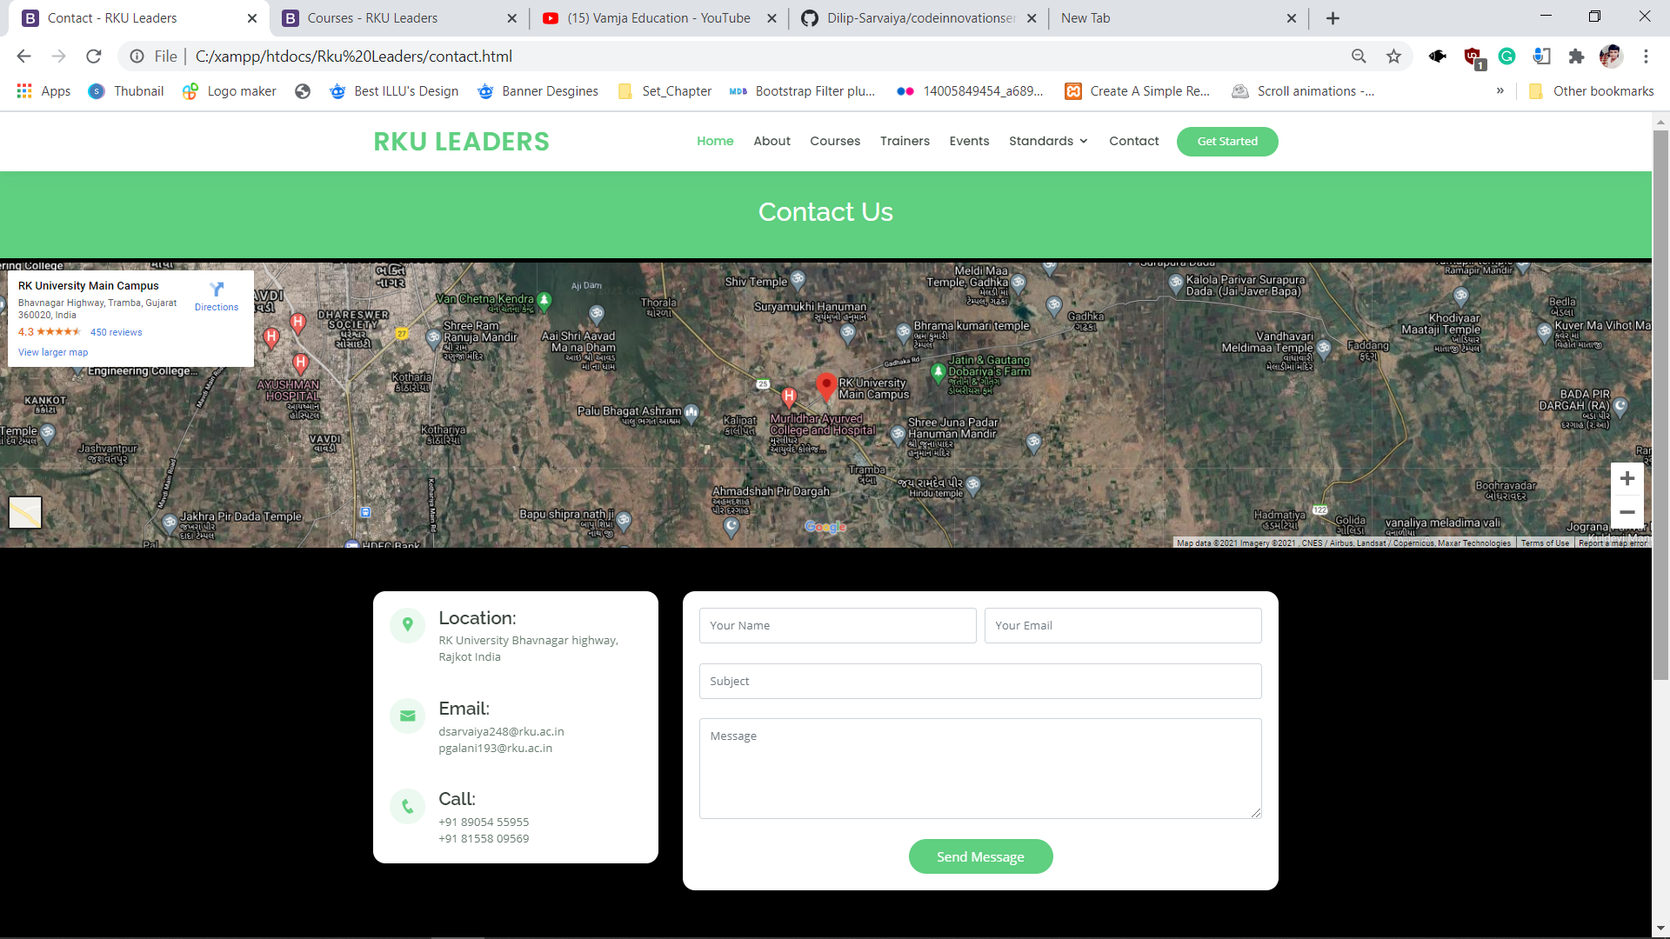
Fourth Task
4. Give Control With Personalized eLearning Experiences
while designing eLearning courses, it is important to make the learner feel as if they are in control of their learning.
Additionally, personalization can be in the form of:
The option of choosing own learning path
Using avatars
Branching Scenarios
Choosing courses based on skill gaps identified

Slide 12
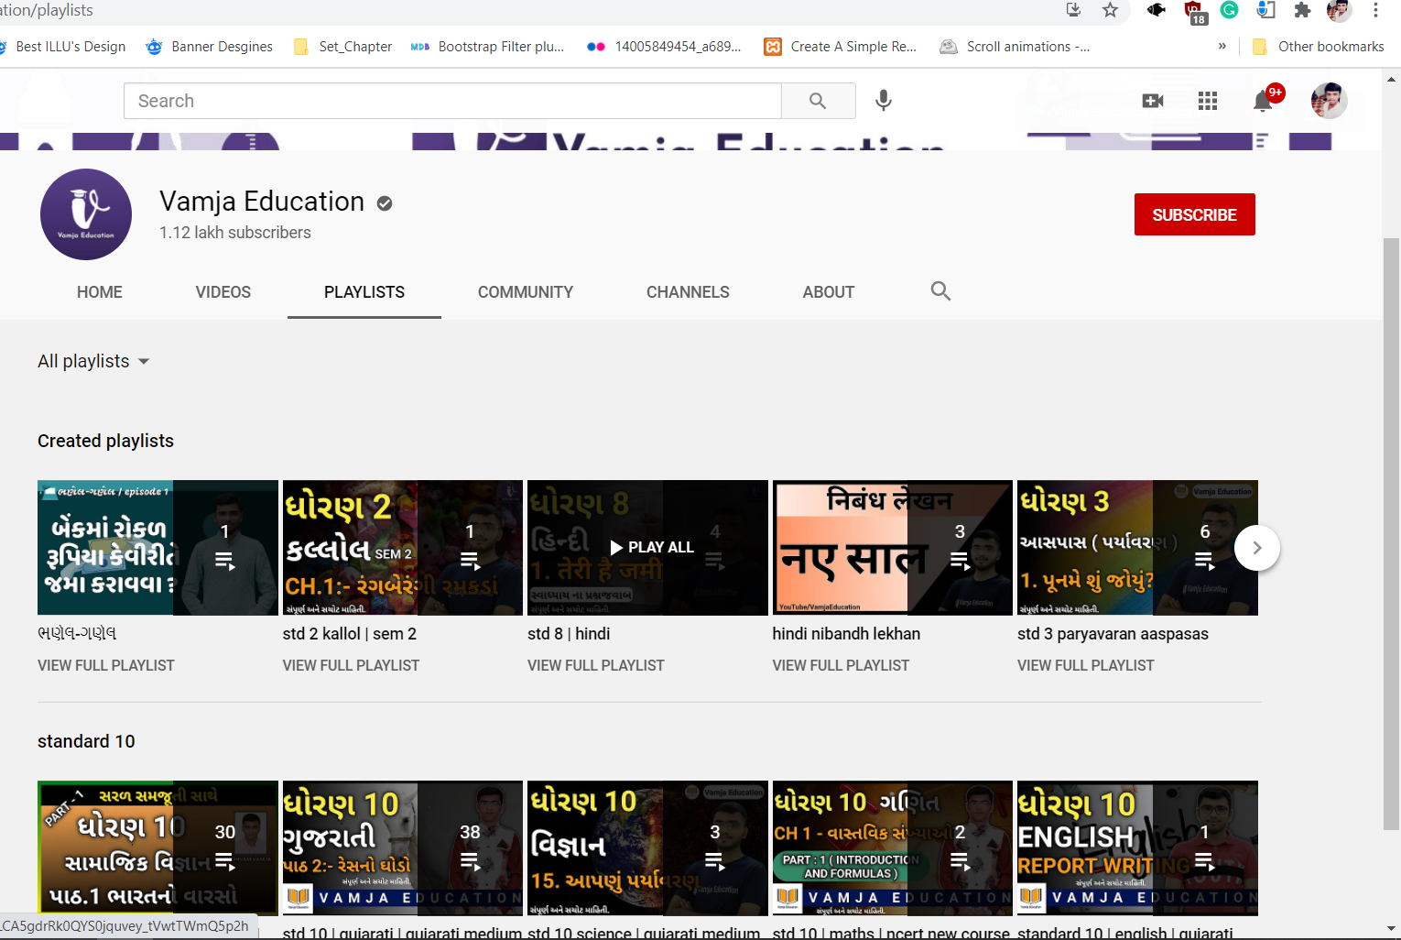
Fifth Task
STUDENT LEARNING OUTCOMES are the measurable knowledge or skills that students will walk away with after completing your course. These outcomes may involve knowledge (cognitive), skills
(behavioral), or attitudes (affective) that display evidence that learning has occurred, at a specified
level of competency, as a result of a course or program.
Learning outcomes are clear and assessable statements that define what a student is able to DO at the completion of a course or program. Best practices in writing student learning outcomes (SLOs) are summarized below:

Slide 13
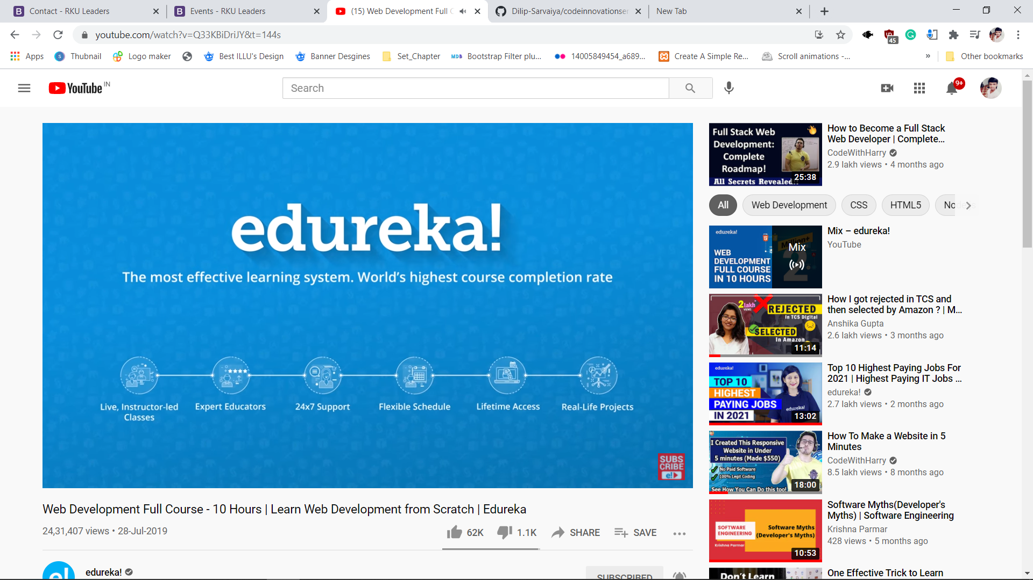
Fifth Task
The SLOs are specific to the course/program they are associated with.
The SLOs focus on what is critical to the course/program.
The SLOs are observable, measurable and, thus, are assessable. It should be feasible to measure the outcome directly or to measure things that reasonably indicate that students have attained the
outcome..

Slide 14
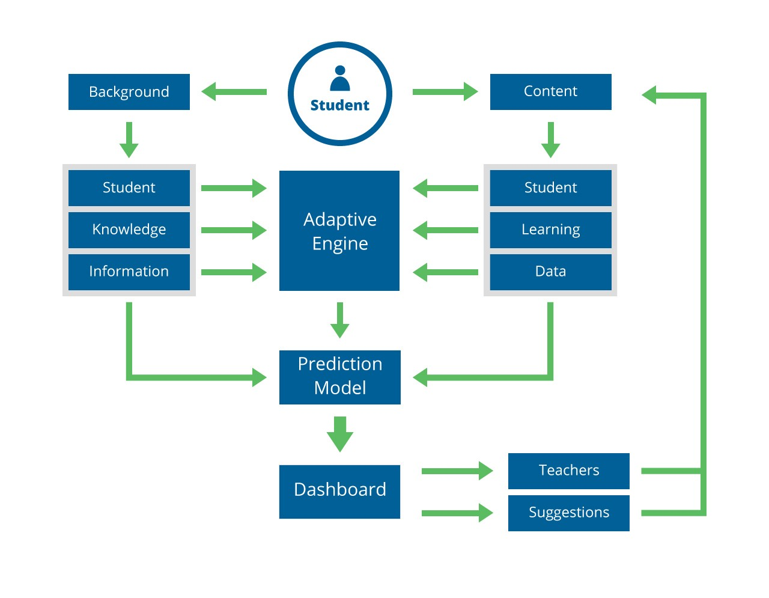
Sixth Task

Slide 15

Course Progress
Task 1
Transforming learning into Amazing e-learning Experiences
Lack Of Learner Motivation And Engagement
Task 3
Staying Up-To-Date With Modern Tech.
Task 4
Designing e-learning Courses For Different Generations.
Task 5
Measurable learning outcomes
Task 6
Adaptive learner models to accommodate different learner needs.
Task 2

Slide 16
A link to the video demonstration of our working model is following...
https://drive.google.com/file/d/1dCH_jv9KV864L4lpevCzkwi9xAQ-Tszt/view?usp=sharing

Slide 17

Thank You!

